Slide 1



EMPLOYEE ATTRITION ANALYSIS

Slide 2

INTRODUCTION
The Human Resources (HR) department of any organization is responsible for managing the company's most valuable asset: its employees. The HR dataset provides a wealth of information about employees, including their demographics, job roles, and performance. In this analysis, we will explore the data to gain insights into various aspects of employee attrition, demographics, and other key factors that impact employee retention.

Slide 3

DETAILS OF DATA
The HR dataset used in this analysis was sourced from Kaggle, a data science community, and platform. The dataset contains information on 4410 employees, including their age, gender, job roles, monthly income, years worked, and whether they have left the company (attrition).

Slide 4
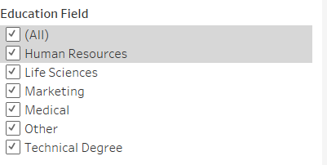
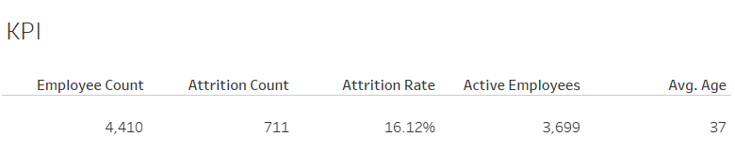
KPI

Slide 5
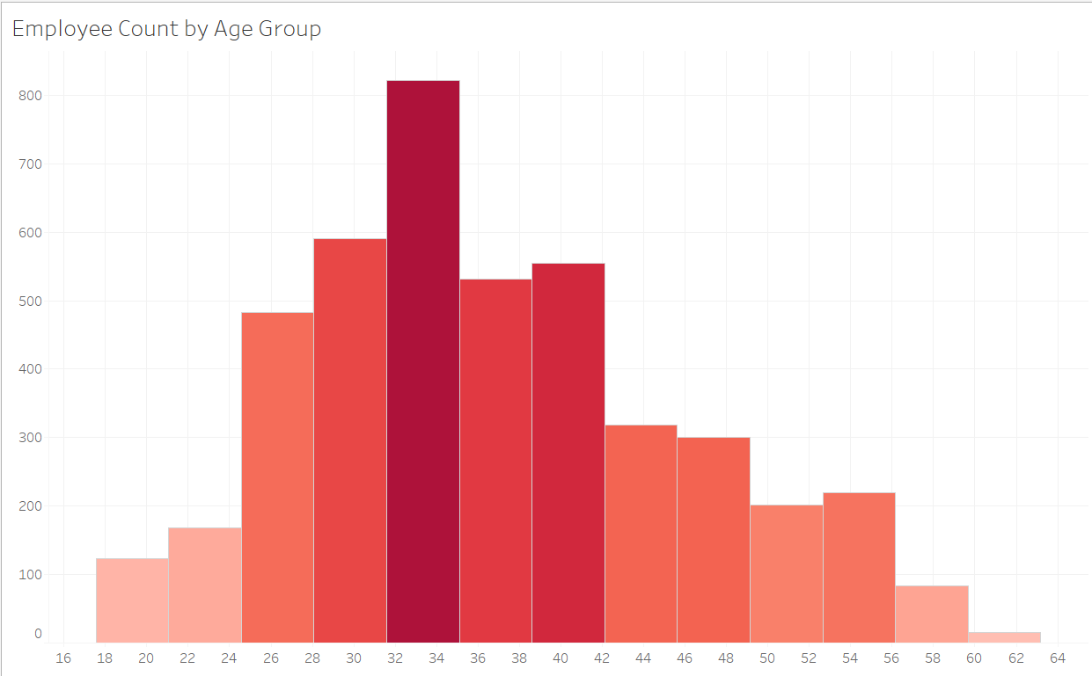
EMPLOYEE COUNT BY AGE GROUP

Slide 6
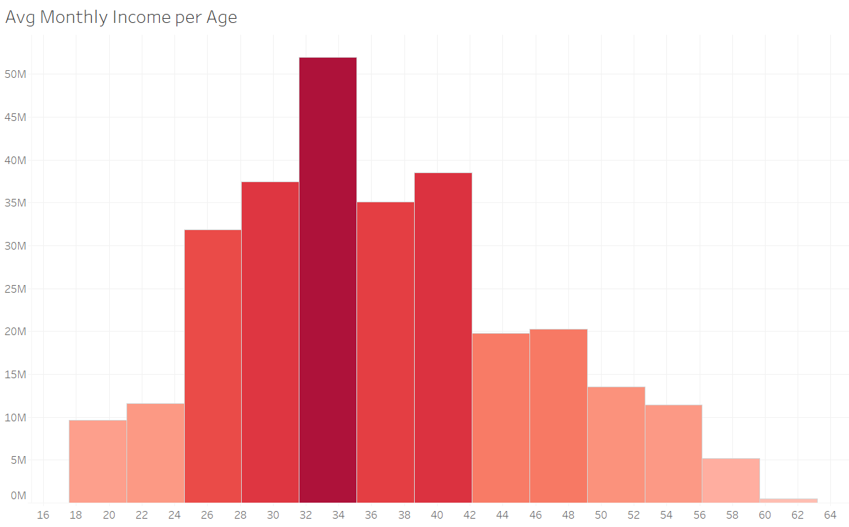
AVERAGE MONTHLY INCOME PER AGE

Slide 7
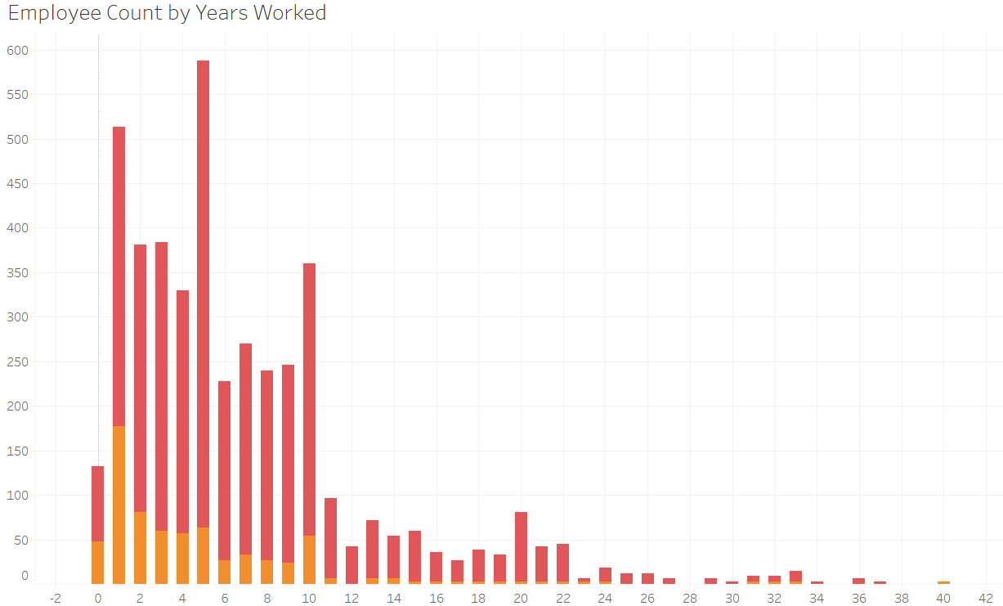
EMPLOYEE COUNT BY YEARS WORKED

Slide 8
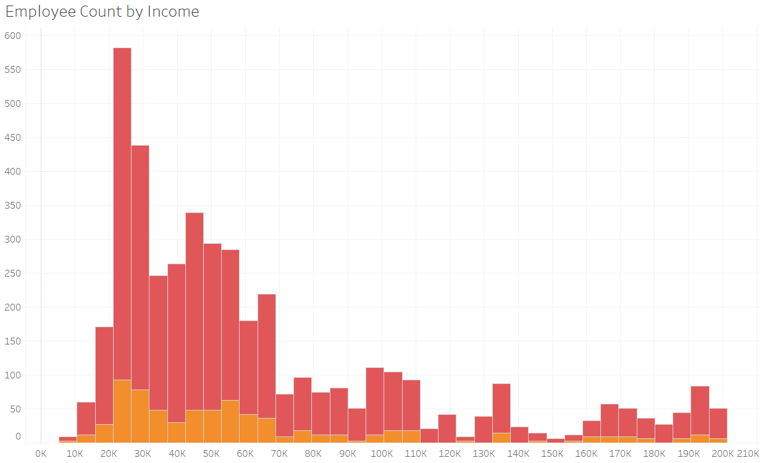
EMPLOYEE COUNT BY INCOME

Slide 9
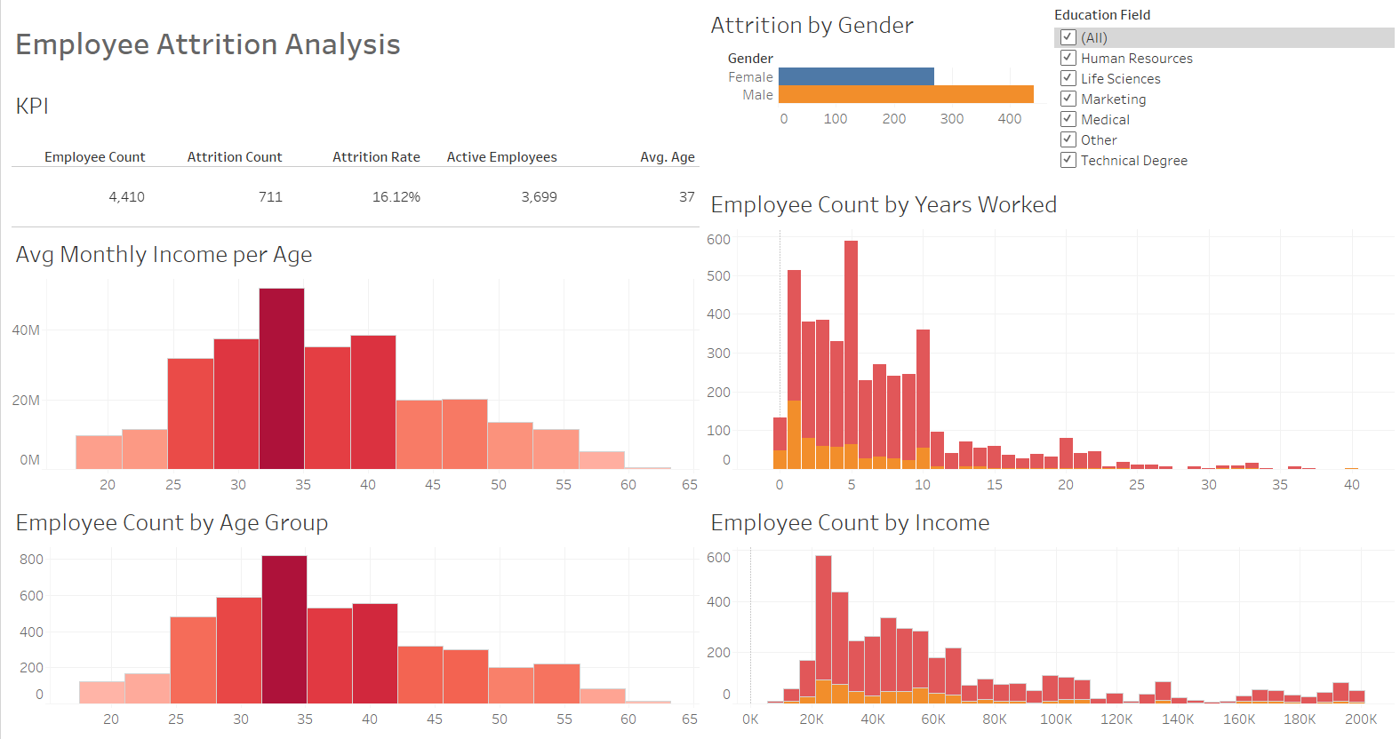
DASHBOARD

Slide 10

THANK
YOU!

